Slide 1
Challenges
Mini challenge 4

Slide 2
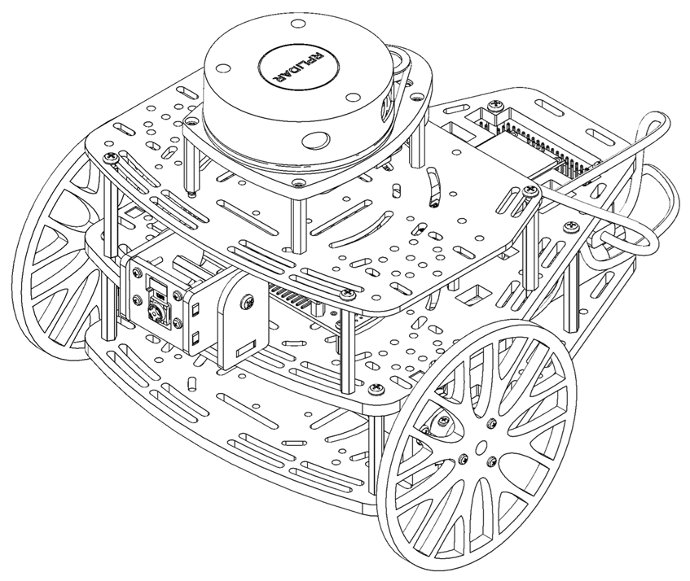
Mini Challenge 4: Line Following
This challenge is intended for the student to review the concepts introduced in this week.
This challenge aims to show the behaviour of vision systems in mobile robotics.
This challenge will be divided in different sections.

Slide 3
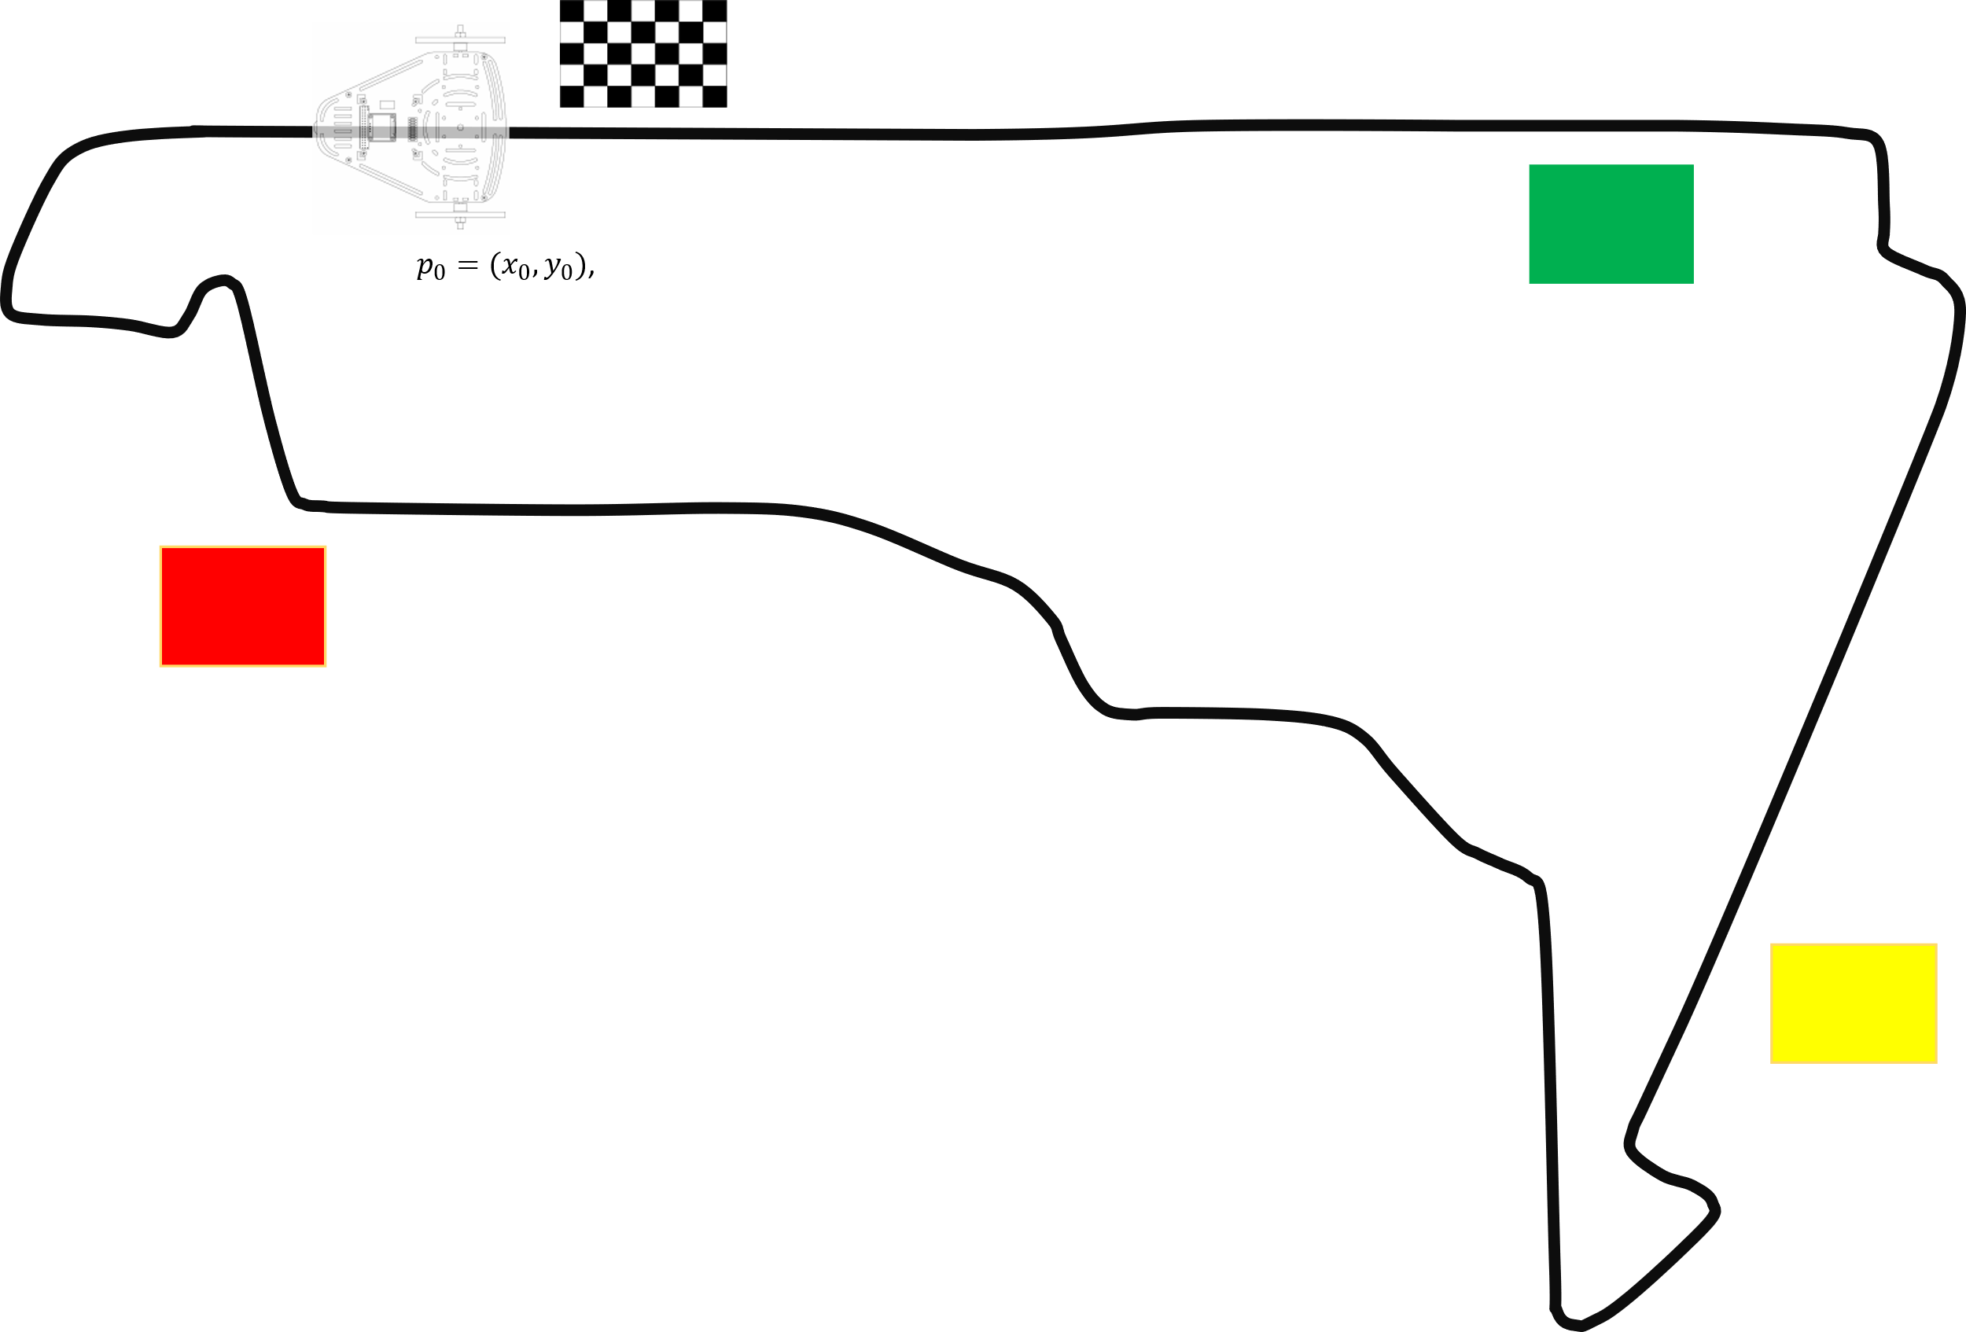
Mini Challenge 4
In this challenge, the student must use and combine the knowledge developed in previous activities.
Add a line following layer to your previously developed decision layer and point-to-point navigation algorithm, to follow a line using the Puzzlebot camera.
The expected behaviour is:
Make a robust algorithm to follow a line using the camera of the robot.
The track must be comprised of 3 lines with certain measurements (measurements in the following slides).
The line tracks must be designed by the students.
The behaviour of the algorithm must take into consideration the previous challenge of the traffic light.
Red Flag (Stop): Stop until you see a green light.
Yellow Flag (Caution): Drive slowly, until you see a Red Light to stop.
Green Flag (Go): Continue with your Path.
Example Track “Autodromo Hermanos Rodriguez” Mexico City, Mexico

Slide 4
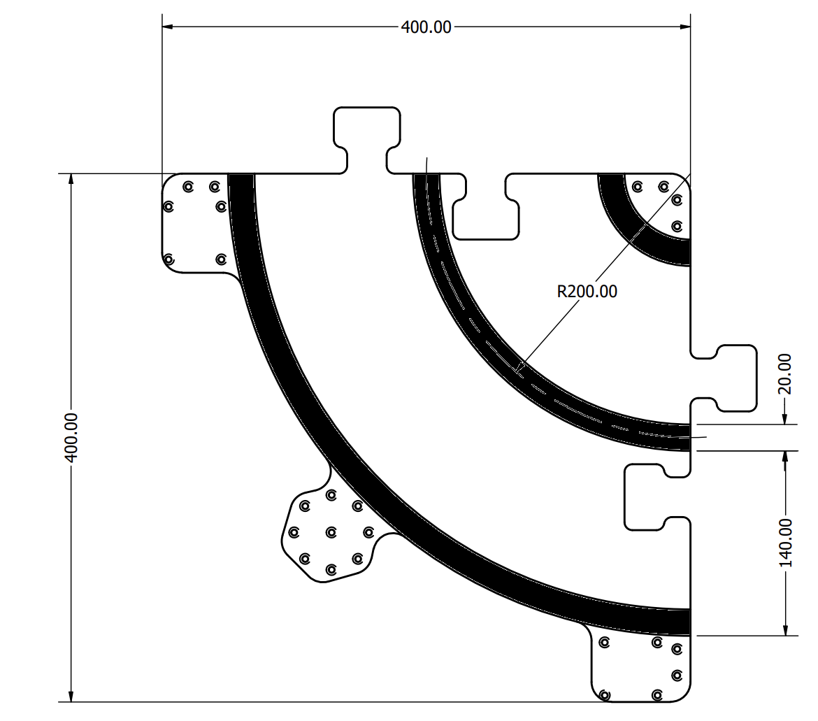
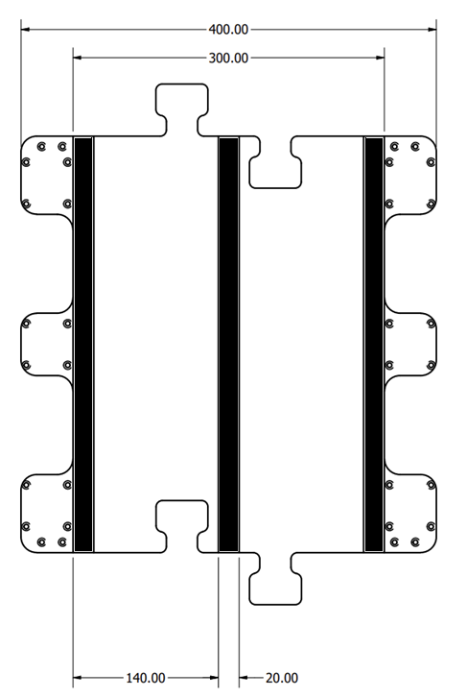
Mini Challenge 4
The line following vision algorithm and closed-loop controller must be robust.
The student must define what robustness is, and implement strategies to achieve it with the controller.
The vision algorithms, line following algorithms and the controller must be tuned properly.
It is encouraged but not mandatory to recognise the Checkered flag to finish the course.
The controller must take into consideration, changes in light, perturbation, nonlinearities and noise.
It is encouraged, but not required, for the student to use a config file or a parameter in the launch file to establish the goal targets such that they can be changed outside the code (not hardcoded).
Track Measurements

Slide 5
Rules
This is challenge not a class. The students are encouraged to research, improve tune explain their algorithms by themselves.
MCR2(Manchester Robotics) Reserves the right to answer a question if it is determined that the questions contains partially or totally an answer.
The students are welcomed to ask only about the theoretical aspect of the classed.
No remote control or any other form of human interaction with the simulator or ROS is allowed (except at the start when launching the files).
It is forbidden to use any other internet libraires with the exception of standard libraires or NumPy.
If in doubt about libraires please ask any teaching assistant.
Improvements to the algorithms are encouraged and may be used as long as the students provide the reasons and a detailed explanation on the improvements.
All the students must be respectful towards each other and abide by the previously defined rules.
Manchester robotics reserves the right to provide any form of grading. Grading and grading methodology are done by the professor in charge of the unit.

